Slide 1
BRANCH -EE
SEMESTER-6th
MICROPROCESSOR
&
MICROCONTROLLERS

Slide 2
Table of contents
01
Introduction to 8 bit and 16 bit Microprocessors-H/W architecture
02
16-bit microprocessor instruction set and assembly language programming
03
8-bit microcontroller- H/W architecture instruction set and programming
Microprocessor peripheral interfacing.
04
05
Maximum mode system configuration.

Slide 3
01
Introduction to 8 bit and 16 bit Microprocessors-H/W architecture

Slide 4
TO DISCUSS
Introduction to microprocessor, computer and its organization, Programming system; Address bus, data bus and control bus, Tristate bus;.
clock generation; Connecting Microprocessor to I/O devices; Data transfer schemes; Architectural advancements of microprocessors. Introductory System design using microprocessors;
8086 – Hardware Architecture; External memory addressing; Bus cycles; some important Companion Chips; Maximum mode bus cycle;
8086 system configuration; Memory Interfacing; Minimum mode system configuration, Interrupt processing.

Slide 5
MICROPROCESSOR
A microprocessor is a computer processor where the data processing logic and control is included on a single integrated circuit, or a small number of integrated circuits. The microprocessor contains the arithmetic, logic, and control circuitry required to perform the functions of a computer's central processing unit.
The following features enable microprocessor to be a versatile component in an instrumentation system.
Memory.
Decision making power based on previously entered values
Repeatability of the reading.
Digital read-out and interactiveness.
Parallel Processing.
Time sharing and multiprocessing.

Slide 9
\

Slide 12
.

Slide 13
TYPES OF BUSES
* The width of the address bus determines the amount of memory a system can address. For example, a system with a 32-bit address bus can address 2³² (4,294,967,296) memory locations. If each memory location holds one byte, the addressable memory space is 4 GiB.
* A databus is a data-centric software framework for distributing and managing real-time data in intelligent distributed systems. It allows applications and devices to work together as one, integrated system.
* The control bus is a bidirectional and assists the CPU in synchronizing control signals to the internal components and the external devices connected to the system. The control bus transmits the control signals such as device interrupt signal , byte enable signal , memory read or write signals and status signals.

Slide 14
TRISTATE BUS
*A three state bus buffer is an integrated circuit that connects multiple data sources to a single bus. The open drivers can be selected to be either a logical high, a logical low, or high impedance which allows other buffers to drive the bus.
* Tristate means three states viz. Logic 0, Logic 1 and high impedance states. In high impedance state, the pin neither connected to supply nor to ground. Hence impedance at this pin is very high with respect to suppy as well as ground. Some pins of 8085 have three states.

Slide 16
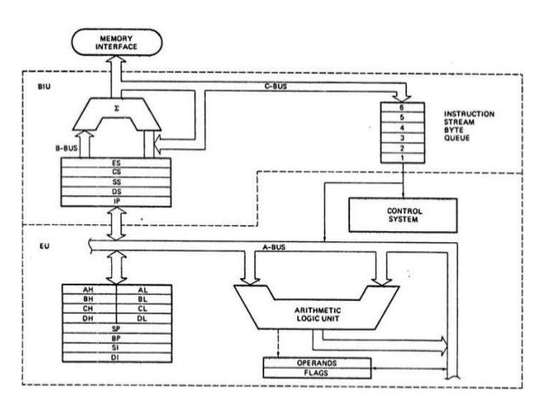

Slide 19
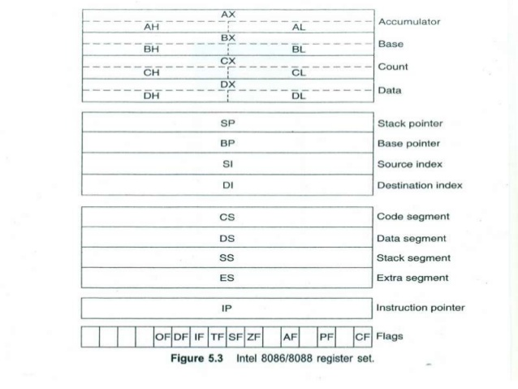

Slide 21
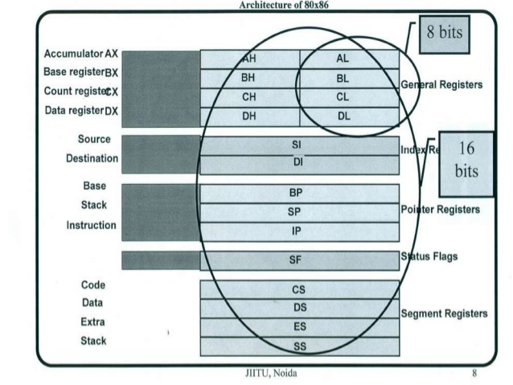

Slide 24
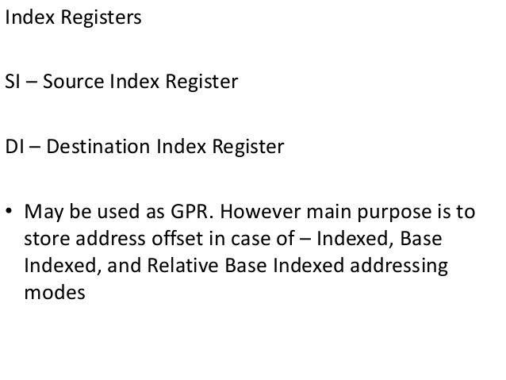

Slide 25
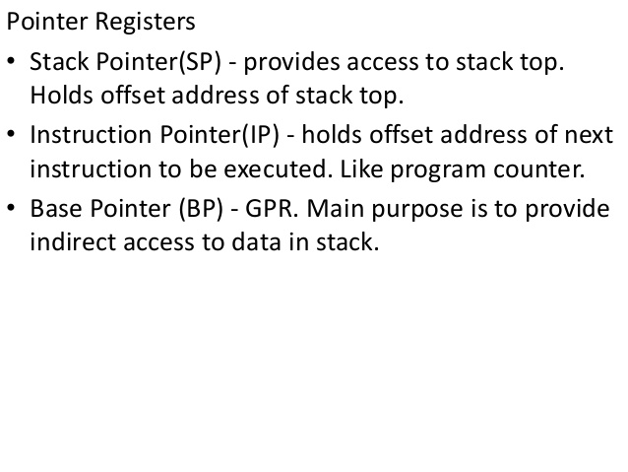

Slide 26
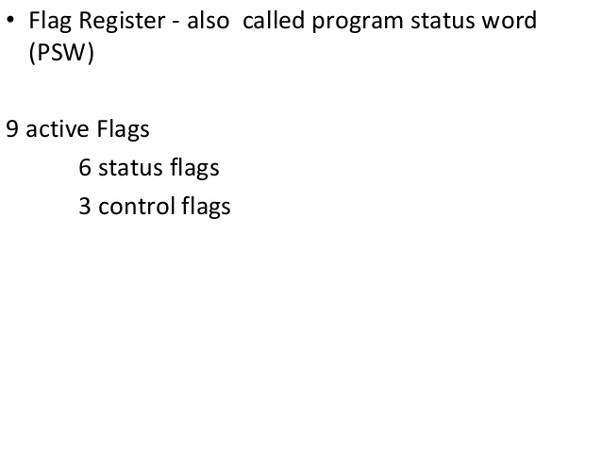

Slide 27
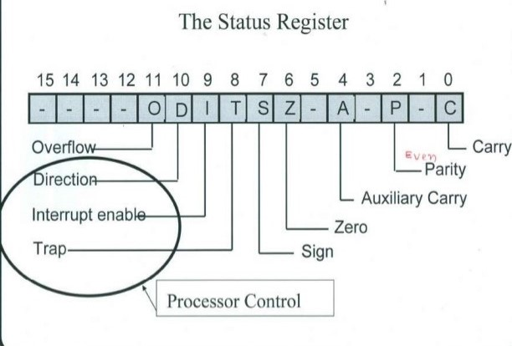

Slide 31
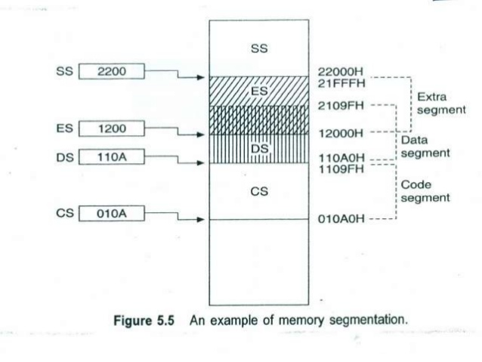

Slide 32
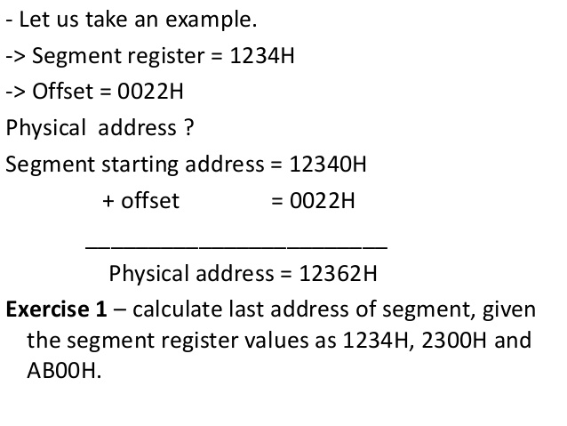

Slide 33
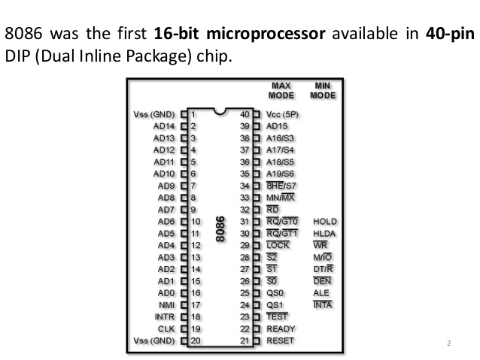
8086 PIN DIAGRAM

Slide 34
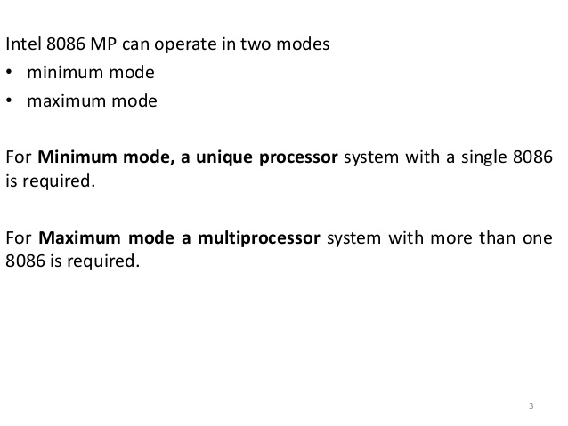

Slide 35
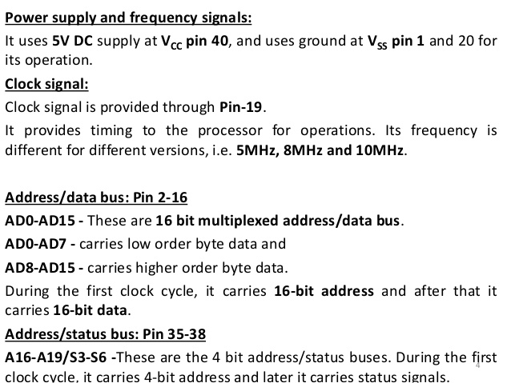

Slide 36
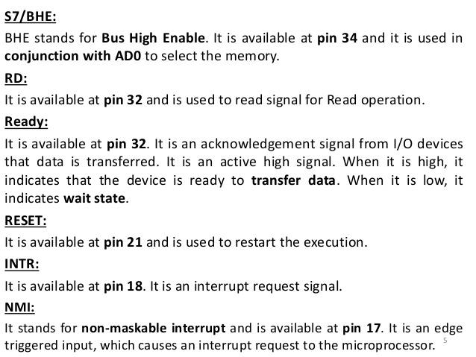

Slide 37
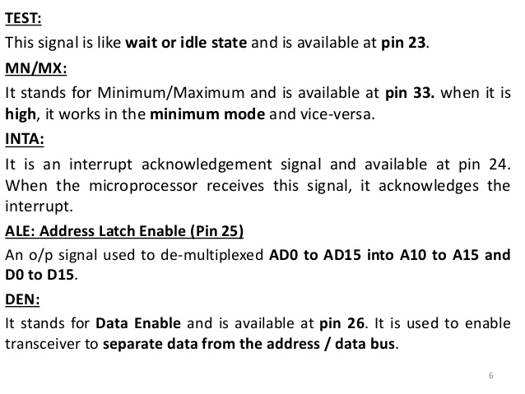

Slide 40
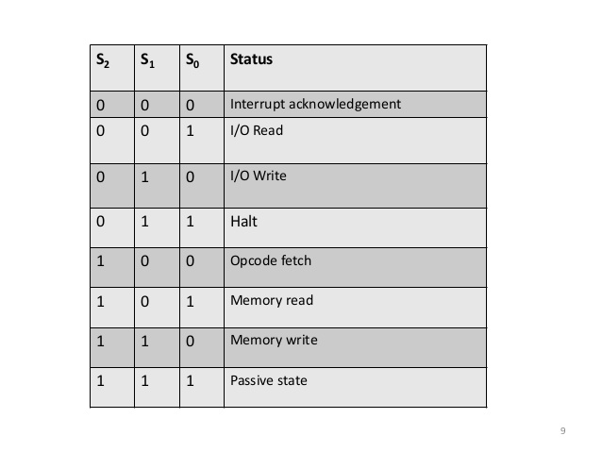

Slide 42
SHORT QUESTION WITH ANSWER
1. A microcontroller at-least should consist of: a) RAM, ROM, I/O ports and timers b) CPU, RAM, I/O ports and timers c) CPU, RAM, ROM, I/O ports and timers d) CPU, ROM, I/O ports and timers
Answer: c
2.What is the order decided by a processor or the CPU of a controller to execute an instruction? a) decode,fetch,execute b) execute,fetch,decode c) fetch,execute,decode d) fetch,decode,execute
Answer: d

Slide 43
3.A microprocessor is a chip integrating all the functions of a CPU of a computer.
multiple B. single C. double D. triple
ANSWER: B
4. The purpose of the microprocessor is to control
A. memory B. switches C. processing D. task
ANSWER: A
5. The first digital electronic computer was built in the year A. 1950 B. 1960 C. 1940 D. 1930
ANSWER: C
6. In 1960's texas institute invented
A. integrated circuits B. microprocessor C. vacuum tubes D.. transistors
ANSWER: A
7. The intel 8086 microprocessor is a processor
8 bit B. 16 bit C. 32 bit D. 4 bit
ANSWER: B

Slide 44
8. The microprocessor can read/write 16 bit data from or to
A. memory B. I /O device C. processor D. register
ANSWER: A
9. In 8086 microprocessor , the address bus is bit wide
A. 12 bit B. 10 bit C. 16 bit D. 20 bit
ANSWER: D
10. The work of EU is
encoding B. decoding C. processing D. calculations
ANSWER: B
11. The 16 bit flag of 8086 microprocessor is responsible to indicate
A. the condition of result of ALU operation B. the condition of memory C. the result of addition D. the result of subtraction
ANSWER: A
12. The CF is known as
A. carry flag B. condition flag C. common flag D. single flag
.ANSWER: A

Slide 45
13. The SF is called as
A. service flag B. sign flag C. single flag D. condition flag
ANSWER: B
14. The OF is called as A. overflow flag B. overdue flag C. one flag D. over flag
ANSWER: A
15. The IF is called as
initial flag B. indicate flag C. interrupt flag D. inter flag
16. The register AX is formed by grouping
A. AH & AL B. BH & BL C. CH & CL D. DH & DL
ANSWER: C
ANSWER: A
17. The SP is indicated by A. single pointer B. stack pointer C. source pointer D. destination pointer
ANSWER: B
18. The BP is indicated by
A. base pointer B. binary pointer C. bit pointer D. digital pointer
ANSWER: A
19. The SS is called as
A. single stack B. stack segment C. sequence stack .D. random stack ANSWER: B
20. The index register are used to hold
A. memory register B. ofset address C. segment memory D. offset memory
ANSWER: A

Slide 46
02
16-bit microprocessor instruction set and assembly language programming

Slide 47
TO DISCUSS
Programmer’s model of 8086; operand types, operand addressing;
assembler directives, instruction Set-Data transfer group,
Arithmetic group, Logical group.

Slide 52
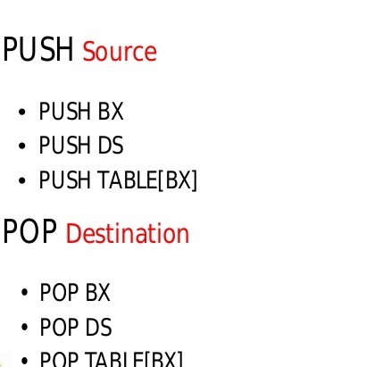

Slide 56
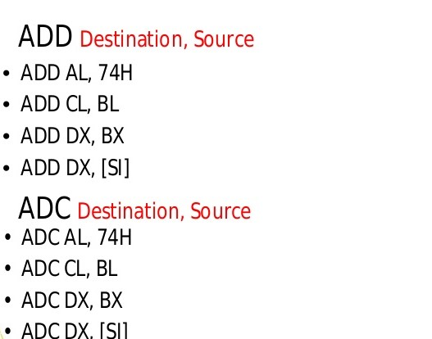

Slide 59
SHORT QUESTION WITH ANSWER
The BIU contains FIFO register of size bytes
A. 8 B. 6 C. 4 D. 12
ANSWER: B
2. The BIU prefetches the instruction from memory and store them in
A. queue B. register C. memory D. stack
ANSWER: A
3. The 1 MB byte of memory can be divided into segment
A. 1 Kbyte B. 64 Kbyte C. 33 Kbyte D. 34 Kbyte
ANSWER: B
4. The DS is called as
A. data segment B. digital segment C. divide segment D. decode segment ANSWER: A
5. The CS register stores instruction in code segment
A. stream B. path C. codes D. stream line
ANSWER: C
6. The IP is bits in length A. 8 bits B. 4 bits C. 16 bits D. 32 bits
ANSWER: C

Slide 60
7. The push source copies a word from source to
stack B. memory C. register D. destination
ANSWER: A
8. LDs copies to consecutive words from memory to register and
A. ES B. DS C. SS D. CS
ANSWER: B
9. INC destination increments the content of destination by
A. 1 B. 2 C. 30 D. 41
ANSWER: A
10. IMUL source is a signed
multiplication B. addition C. subtraction D. division
ANSWER: A
11. destination inverts each bit of destination
NOT B. NOR C. AND D. OR
ANSWER: A
12. The JS is called as
A. jump the signed bit B. jump single bit C. jump simple bit D. jump signal it
ANSWER: A
13. Instruction providing both segment base and offset address are called
A. below type .B. far type C. low type D. high type
ANSWER: B

Slide 61
14. The conditional branch instruction specify for branching
A. conditions B. instruction C. address D. memory
ANSWER: A
15. The microprocessor determines whether the specified condition exists or not by testing the
A. carry flag B. conditional flag C. common flag D. sign flag
ANSWER: B
16. The LES copies to words from memory to register and
A. DS B. CS C. ES D. DS
ANSWER: C
17. The translates a byte from one code to another code
A. XLAT B. XCHNG C. POP D. PUSH
ANSWER: A
18. The contains an offset instead of actual address
A. SP B. IP C. ES D. SS
ANSWER: B
19. The 8086 fetches instruction one after another from of memory A. code segment B. IP C. ES D. SS
ANSWER: A
20. The BIU contains FIFO register of size 6 bytes called . A. queue B. stack C. segment D. register
ANSWER: A

Slide 63
03
Microprocessor peripheral interfacing.

Slide 64
TO DISCUSS
Introduction; Generation of I/O ports; Programmable Peripheral Interface (PPI) - Intel 8255;
Sample-andHold Circuit and Multiplexer;
Keyboard and Display Interface; Keyboard and Display Controller (8279)

Slide 65
BASIC INTERFACING CONCEPT

Slide 66
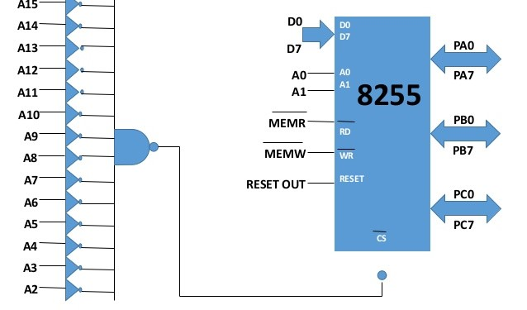
INTERFACING IN MEMORY MAPPED I/O

Slide 67
MEMORY MAPPED I/O

Slide 68
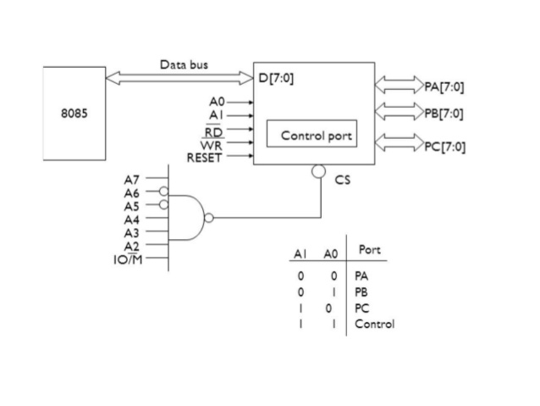

Slide 69
I/O MAPPED I/O

Slide 70
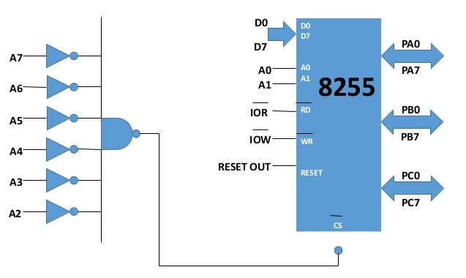
INTERFACING IN I/O MAPPED I/O

Slide 71
8255 PPI

Slide 72
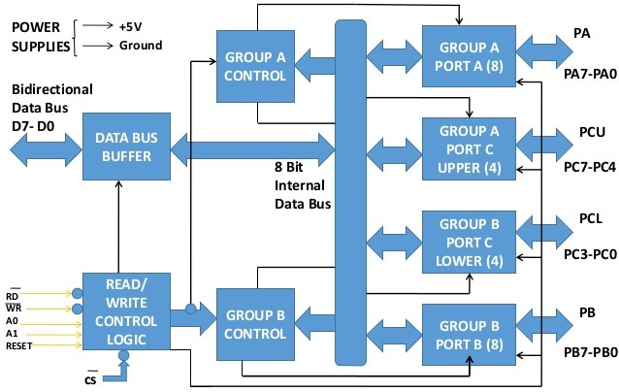
BLOCK DIAGRAM OF 8255 PPI

Slide 73
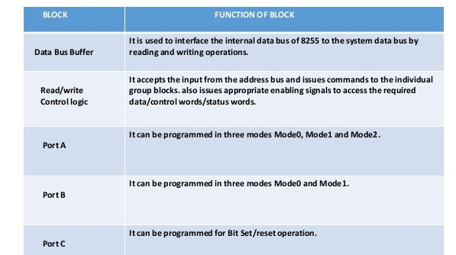
FUNCTION OF BLOCKS

Slide 74
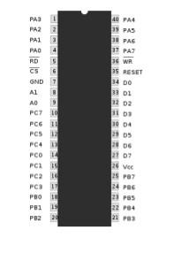
8255 PIN DIAGRAM

Slide 75
PIN DESCRIPTION

Slide 77
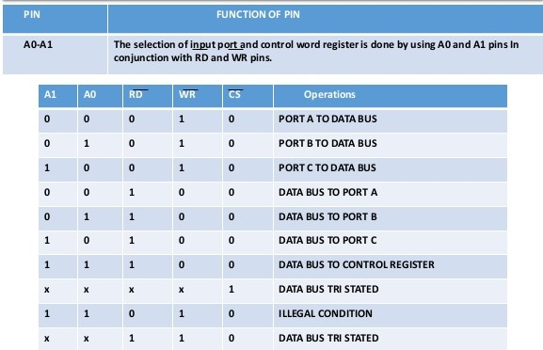

Slide 78
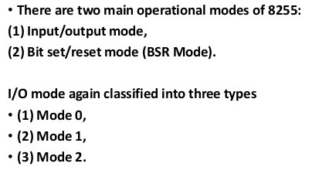
OPERATING MODES OF 8255

Slide 79
MODE 0

Slide 80
MODE 2

Slide 81
SAMPLE & HOLD CIRCUIT & MULTIPLEXER

Slide 82
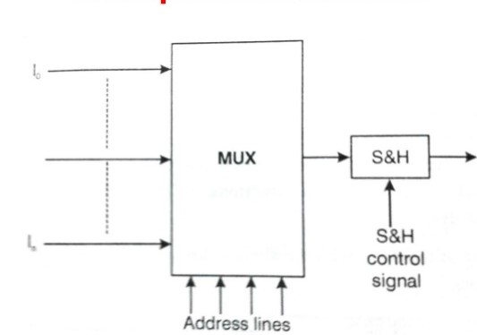
MUX PLACED BEFORE SAMPLE & HOLD

Slide 83
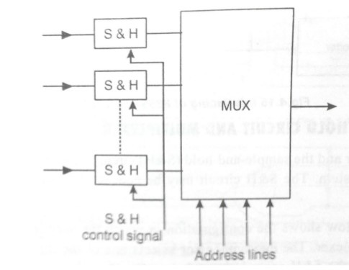
MUX PLACED AFTER SAMPLE &HOLD

Slide 84
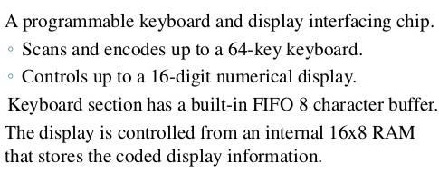
INTRODUCTION OF 8279

Slide 85
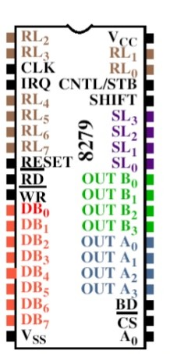
PIN CONFIGURATION OF 8279

Slide 86
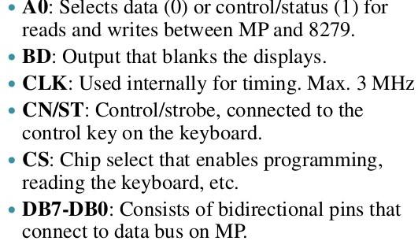

Slide 87
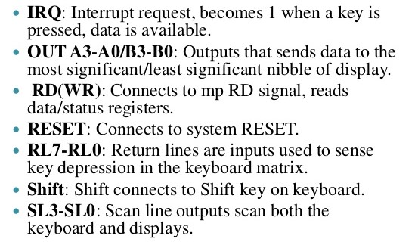

Slide 88
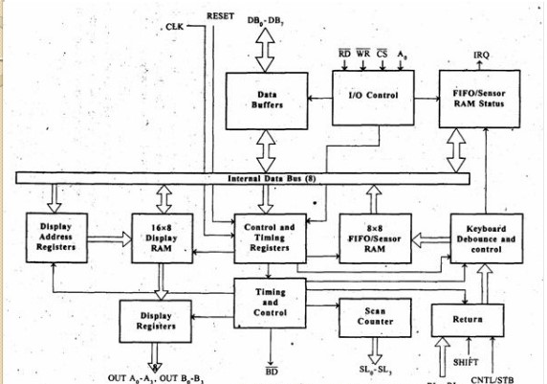
BLOCK DIAGRAM OF 8279

Slide 93
SHORT QUESTION WITH ANSWER
1. The is required to synchronize the internal operands in the processor CLK Signal A. UR Signal B. Vcc C. AIE D. Ground
ANSWER: A
2. The pin of minimum mode AD0-AD15 has address
16 bit B. 20 bit C. 32 bit D. 4 BIT
ANSWER.B
3. The pin of minimum mode AD0- AD15 has _ data bus
A. 4 bit B. 20 bit C. 16 bit D. 32 bit
ANSWER: C
4. The address bits are sent out on lines through
A. A16-19 B. A0-17 C. D0-D17 D. C0-C17 ANSWER: A
5. is used to write into memory
RD B. WR C. RD / WR D. CLK
ANSWER-B

Slide 94
6. The functions of Pins from 24 to 31 depend on the mode in which is operating
A. 8085 B. 8086 C. 80835 D. 80845
ANSWER: B
7. The RD, WR, M/IO is the heart of control for a mode
A. minimum B. maximum C. compatibility mode D. control mod
ANSWER: A
8. In a minimum mode there is a on the system bus
A. single B. double C. multiple D. triple
ANSWER: A
9. If MN/MX is low the 8086 operates in mode
A. Minimum B. Maximum C. both (A) and (B) D. medium
ANSWER: B
10. In max mode, control bus signal So,S1 and S2 are sent out in form
A. decoded B. encoded C. shared D. unshared
ANSWER: B
11. The bus controller device decodes the signals to produce the control bus signal A. internal B. data C. external D. address
ANSWER: C

Slide 95
12. A Instruction at the end of interrupt service program takes the execution back to the interrupted program
A. forward B. return C. data D. line
ANSWER: B
13. The main concerns of the are to define a flexible set of commands
A. memory interface B. peripheral interface C. both (A) and (B) D. control interface
ANSWER: A
14. Primary function of memory interfacing is that the should be able to read from and write into register
A. multiprocessor B. microprocessor C. dual Processor D. coprocessor
ANSWER: B
15. To perform any operations, the Mp should identify the
A. register B. memory C. interface D. system
ANSWER: A
16. The Microprocessor places address on the address bus
A. 4 bit B. 8 bit C. 16 bit D. 32 bit
ANSWER: C

Slide 96
17. The Microprocessor places 16 bit address on the add lines from that address by register should be selected
A. address B. one C. two D. three
ANSWER: B
18. The of the memory chip will identify and select the register for the EPROM
A. internal decoder B. external decoder C. address decoder D. data decoder
ANSWER: A
19. Microprocessor provides signal like to indicate the read operatio
A. LOW B. MCMW C. MCMR D. MCMWR
ANSWER: C
16. To interface memory with the microprocessor, connect register the lines of the address bus must be added to address lines of the chip.
A. single B. memory C. multiple D. triple
ANSWER: B

Slide 97
04
8-bit microcontroller- H/W architecture instruction set and programming.

Slide 98
TO DISCUSS
Introduction to 8051 Micro-Controllers, Architecture; Memory Organization; Special Function register; Port Operation; Memory Interfacing, I/O Interfacing; .
Programming 8051 resources, interrupts; Programmer’s model of 8051; Operand types, Operand addressing; Data transfer instructions, Arithmetic instructions,
Logic instructions, Control transfer instructions; Programming.

Slide 99
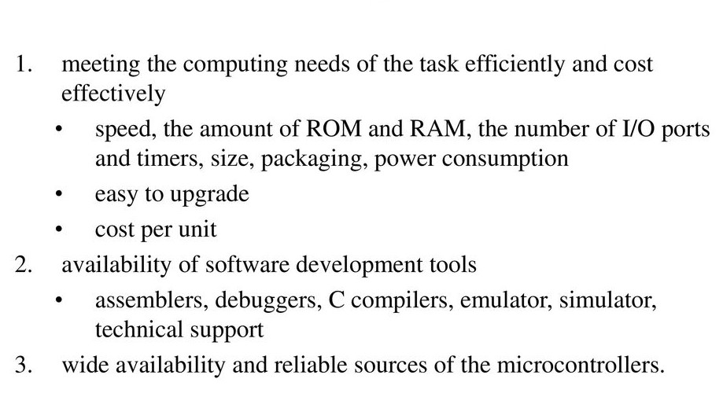
MICROCONTROLLER

Slide 100
8051 MICROCONTROLLER

Slide 101
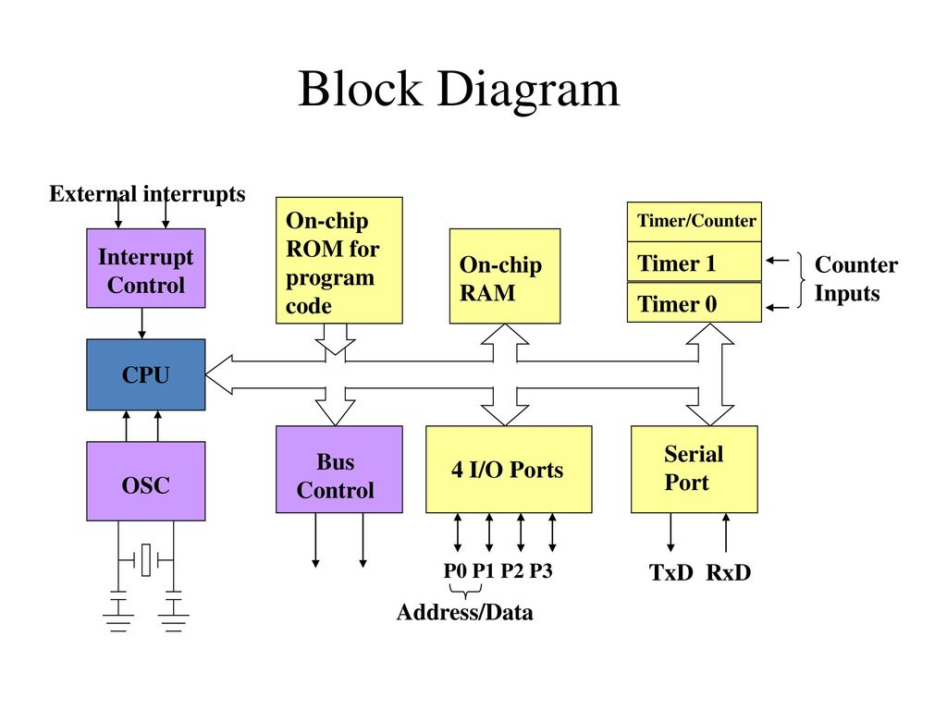

Slide 102
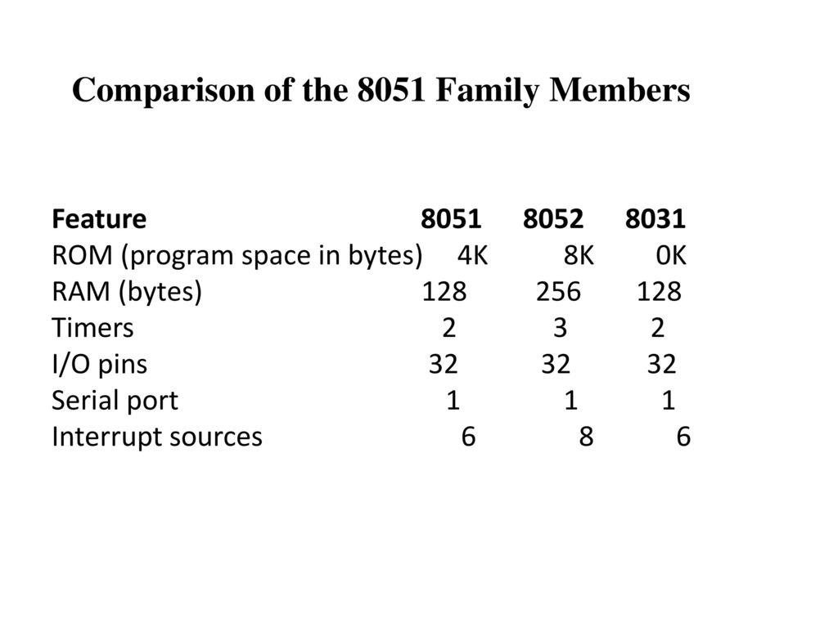

Slide 103
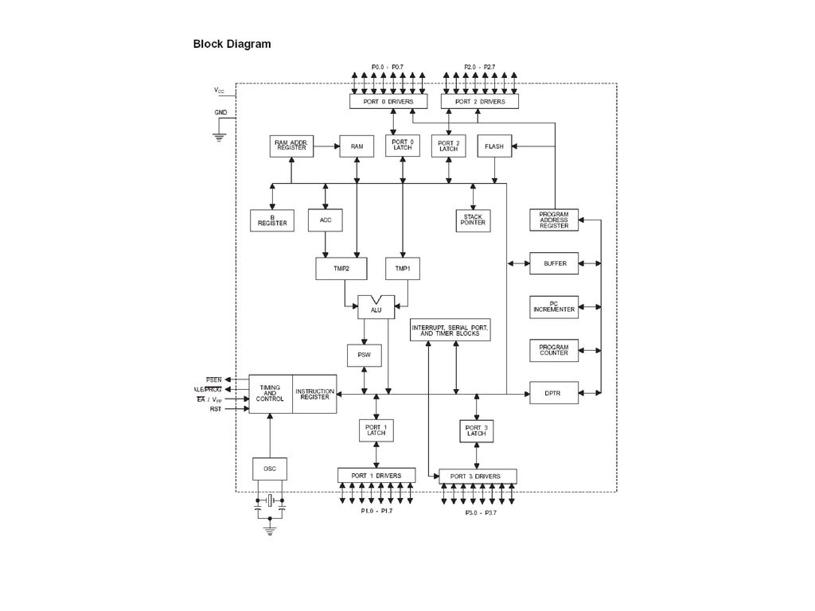

Slide 104
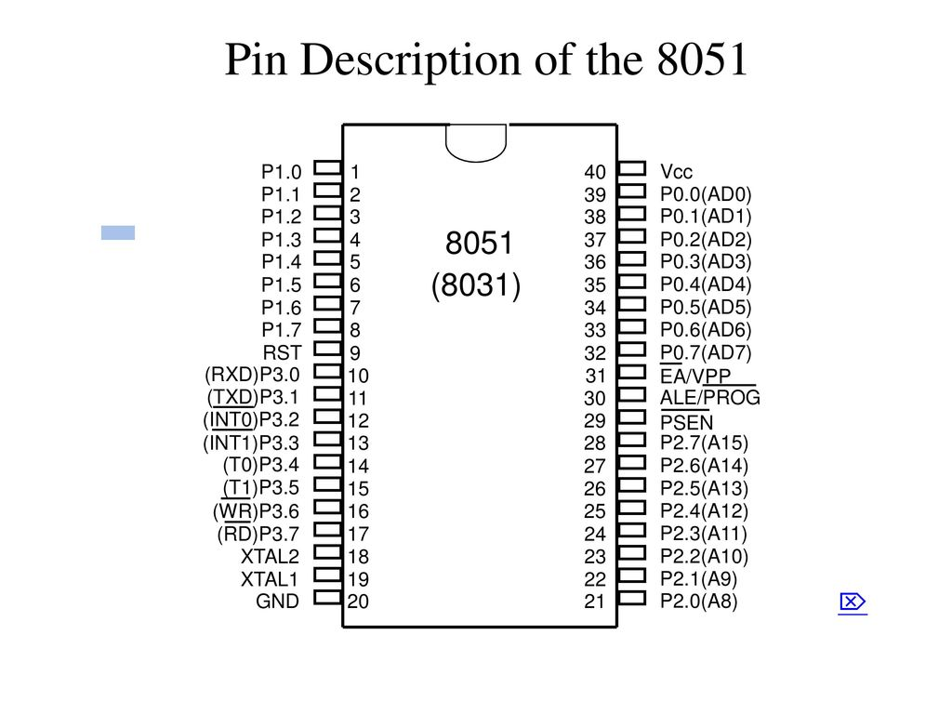

Slide 117
SHORT QUESTION WITH ANSWER
1.. The remaining address line of bus is decoded to generate chip select signal A. data B. address C. control bus D. both (a) and (b)
ANSWER: B
2. signal is generated by combining RD and WR signals with IO/M
A. control B. memory C. register D. system
ANSWER: B
3. Memory is an integral part of a system
A. supercomputer B. microcomputer C. mini computer D. mainframe computer ANSWER: B
4. has certain signal requirements write into and read from its registers A. memory B. register C. both (a) and (b) D. control
ANSWER: A
5. An is used to fetch one address
A. internal decoder B. external decoder C. encoder D. register
ANSWER: A

Slide 118
6. The primary function of the is to accept data from I/P devices
A. multiprocessor B. microprocessor C. peripherals D. interface
ANSWER: B
7. signal prevent the microprocessor from reading the same data more than one
A. pipelining B. handshaking C. controlling D. signaling
ANSWER: B
8. Bits in IRR interrupt are
A. reset B. set C. stop D. start
ANSWER: B
9. generate interrupt signal to microprocessor and receive acknowledge
A. priority resolver B. control logic C. interrupt request register D. interrupt register
ANSWER: B
10. The pin is used to select direct command word
A. A0 B. D7-D6 C. A12 D. AD7-AD6
ANSWER: A

Slide 119
6. The primary function of the is to accept data from I/P devices
multiprocessor B. microprocessor C. peripherals D. interfaces
ANSWER: B
7. signal prevent the microprocessor from reading the same data more than one
A. pipelining B. handshaking C. controlling D. signaling
ANSWER: B
8. Bits in IRR interrupt are
A. reset B. set C. stop D. start
ANSWER: B
9. generate interrupt signal to microprocessor and receive acknowledge
A. priority resolver B. control logic C. interrupt request register D. interrupt register
ANSWER: B
10. The pin is used to select direct command word
A0 B. D7-D6 C. A12 D. AD7-AD6
ANSWER: A
71. The is used to connect more microprocessor
A. peripheral device B. cascade C. I/O devices D. control unit
ANSWER: B

Slide 120
05
Maximum mode system configuration.

Slide 121
TO DISCUSS
Maximum mode system configuration, Direct memory access, Interfacing of D- to-A converter, A-to-D converter,
CRT Terminal Interface, Printer Interface, Programming of 8051 timers, 8051 serial interface
Introduction to 80386 and 80486 Microprocessor family.

Slide 122
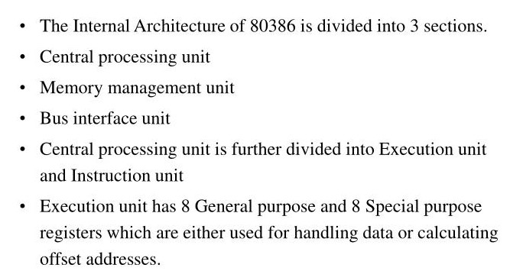
80386 ARCHITECTURE

Slide 123
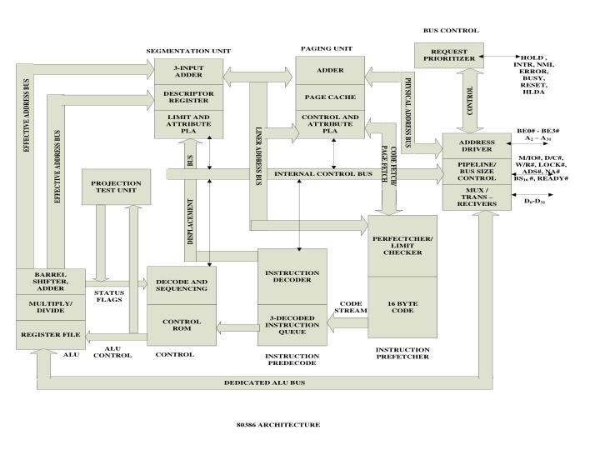

Slide 124
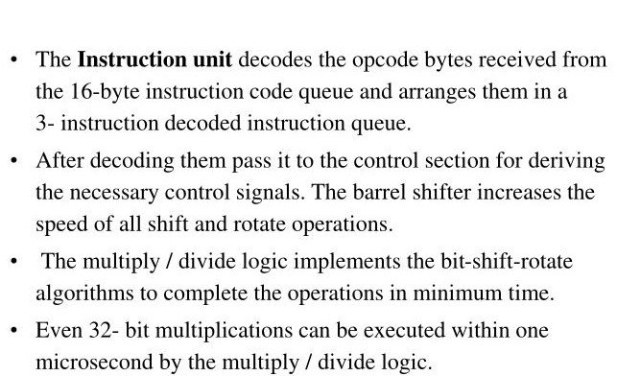

Slide 133
SHORT QUESTION WITH ANSWER
1. The is used to connect more microprocessor
A. peripheral device B. cascade C. I/O devices D. control unit
ANSWER: B
2. CS connect the output of
A. encoder B. decoder C. slave program D. buffer
ANSWER: B
3. Expansion for HMOS technology_
A. high level mode oxygen semiconductor B. high level metal oxygen semiconductor C. high performance medium oxide semiconductor D. high performance metal oxide semiconductor
ANSWER: D
4. ALE stands for
A. address latch enable B. address level enable C. address leak enable D. address leak extension
ANSWER: A

Slide 134
5. Access time is faster for .
A. ROM B. SRAM C. DRAM D. ERAM
ANSWER: B
6. Which is not part of the execution unit (EU)?
A. Arithmetic logic unit (ALU) B. Clock C. General registers D. Flags
Ans.: B
7. Which of the following is not an arithmetic instruction?
A. INC (increment) B. CMP (compare) C. DEC (decrement) D. ROL (rotate left)
Ans.: D
8. During a read operation the CPU fetches _.
A. a program instruction B. another address C. data itself D. all of the above
Ans.: D
9. Which group of instructions do not affect the flags?
A. Arithmetic operations B. Logic operations C. Data transfer operations D. Branch operations
Ans.: C
10. The result of MOV AL, 65 is to store
A. store 0100 0010 in AL B. store 42H in AL C. store 40H in AL D. store 0100 0001 in AL
Ans.: D

